Slide 1

AUTONOMOUS COLOR PEN READER
Capstone project proposal | Fall 2017

Slide 2
1. INTRODUCTION
1
Our members, motivations, significance and existing technologies

Slide 3
Team members
MICHAEL MORDKOVICH (MISHA SYROV)
Project Manager/Software/Hardware Engineer
HAORAN WU (STEVEN WU)
Hardware/Software Engineer
KAIXIAN ZHU (ELLIS ZHU)
Software Engineer
OLUWADARASIMI ADENIYI (DARA ADENIYI)
Project Manager/Hardware Engineer/Researcher
Notes:
This domain has controls around safeguarding assets. Some of the controls that this domain deals with are around the inventory of assets, ownership of assets, acceptable use of assets, return of assets.
It suggests controls around maintaining an inventory of assets and whether that inventory is current and kept up to date.
Also, it suggests that all information assets must have a clearly defined owner who is aware of their responsibilities.
It suggests that there be an acceptable use policy in place and there is process in place by which all employees are made aware of such policies.

Slide 4

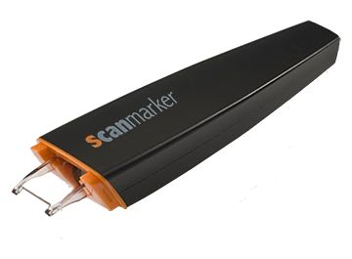
Existing technologies
Existing technologies such as Scan marker and C-Pen don’t read colored text on colored backgrounds well
Notes:
This domain has controls around safeguarding assets. Some of the controls that this domain deals with are around the inventory of assets, ownership of assets, acceptable use of assets, return of assets.
It suggests controls around maintaining an inventory of assets and whether that inventory is current and kept up to date.
Also, it suggests that all information assets must have a clearly defined owner who is aware of their responsibilities.
It suggests that there be an acceptable use policy in place and there is process in place by which all employees are made aware of such policies.

Slide 5
2. SOLUTION DEVELOPMENT
2
Solution proposal and plan of action

Slide 6
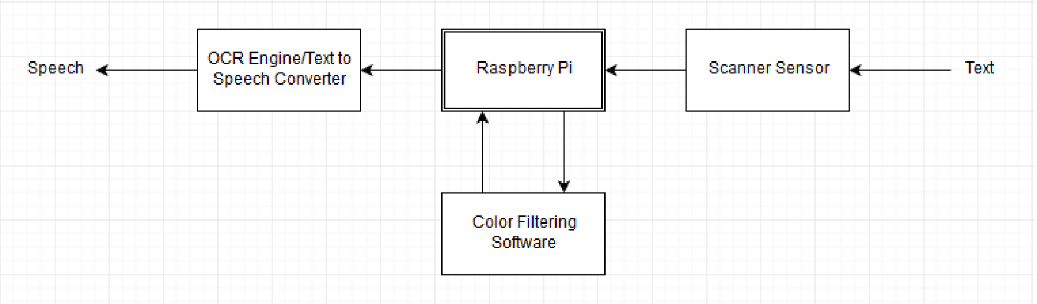
Proposed solution
An electronic image processor that filters out the raw information from the pen reader's scanner
Notes:
This domain has controls around safeguarding assets. Some of the controls that this domain deals with are around the inventory of assets, ownership of assets, acceptable use of assets, return of assets.
It suggests controls around maintaining an inventory of assets and whether that inventory is current and kept up to date.
Also, it suggests that all information assets must have a clearly defined owner who is aware of their responsibilities.
It suggests that there be an acceptable use policy in place and there is process in place by which all employees are made aware of such policies.

Slide 7
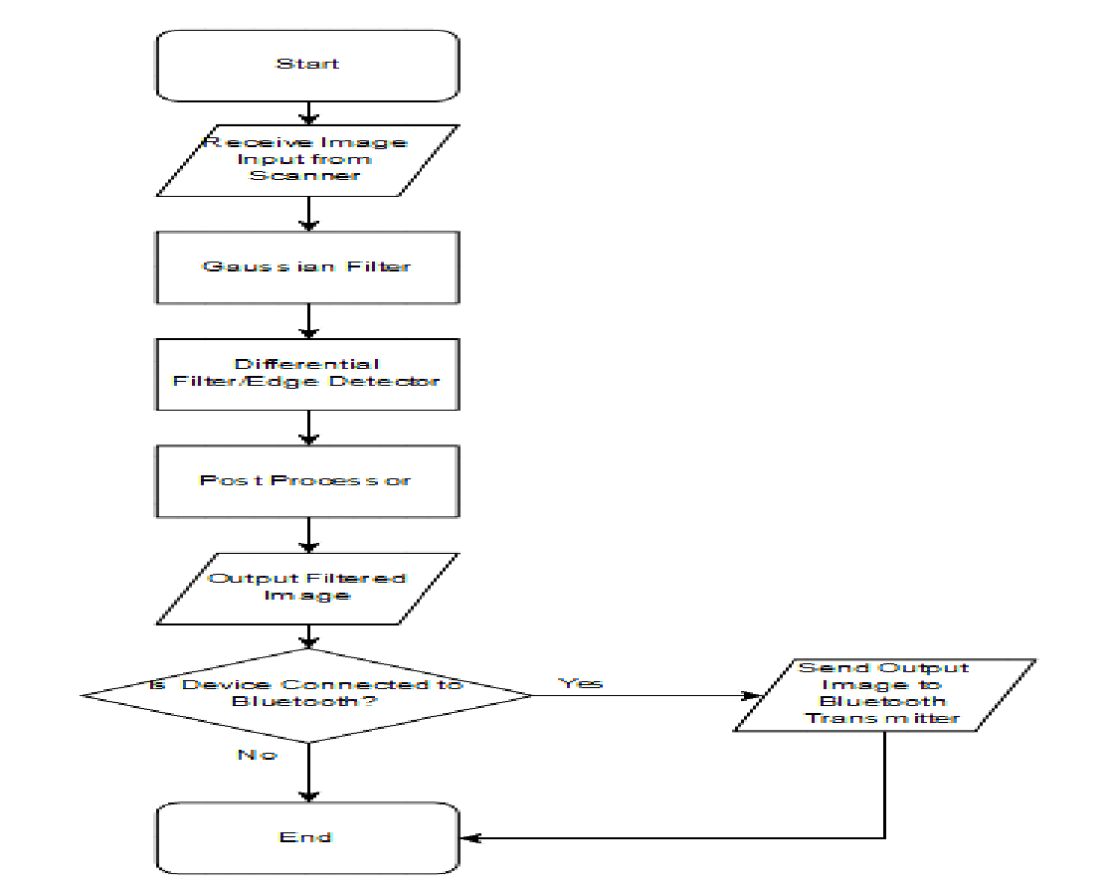
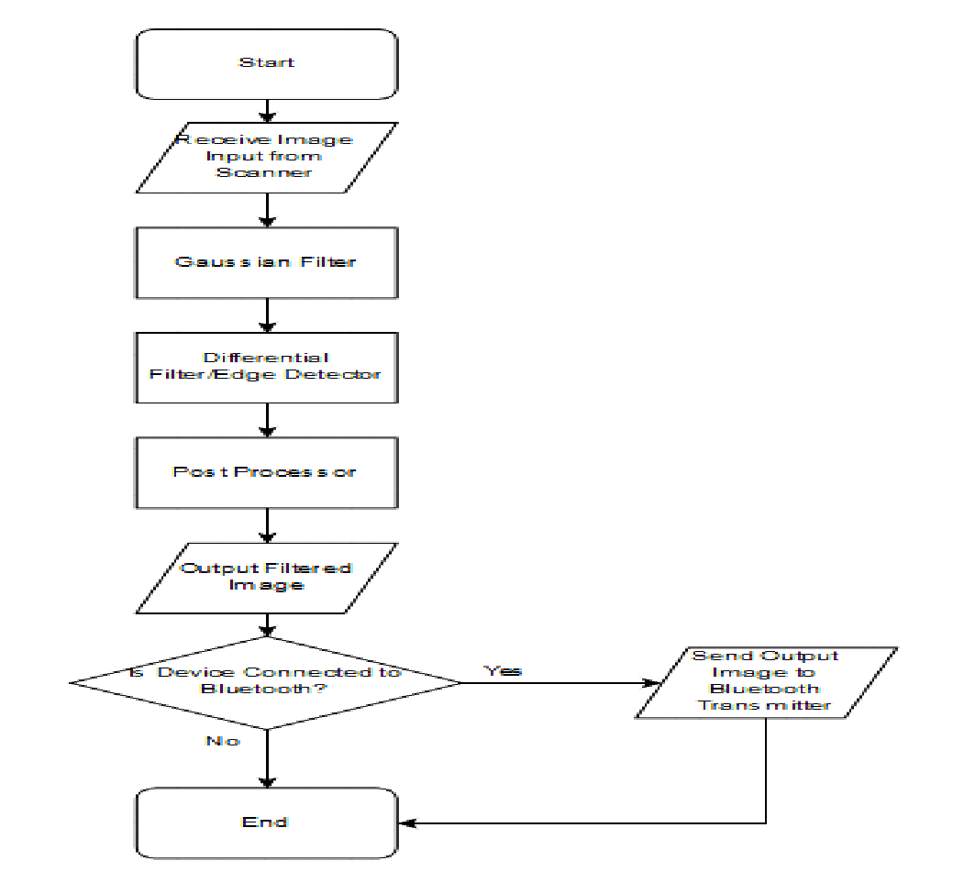

Plan of action
Color filtering diagram:
Notes:
This domain has controls around safeguarding assets. Some of the controls that this domain deals with are around the inventory of assets, ownership of assets, acceptable use of assets, return of assets.
It suggests controls around maintaining an inventory of assets and whether that inventory is current and kept up to date.
Also, it suggests that all information assets must have a clearly defined owner who is aware of their responsibilities.
It suggests that there be an acceptable use policy in place and there is process in place by which all employees are made aware of such policies.

Slide 8
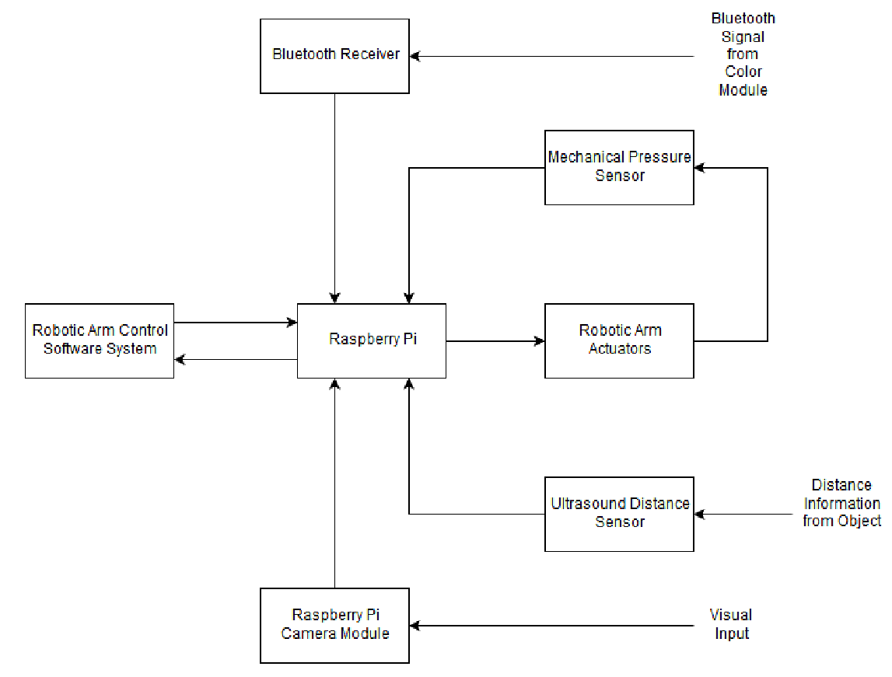
Plan of action
Robotic Arm Control Diagram:
Notes:
This domain has controls around safeguarding assets. Some of the controls that this domain deals with are around the inventory of assets, ownership of assets, acceptable use of assets, return of assets.
It suggests controls around maintaining an inventory of assets and whether that inventory is current and kept up to date.
Also, it suggests that all information assets must have a clearly defined owner who is aware of their responsibilities.
It suggests that there be an acceptable use policy in place and there is process in place by which all employees are made aware of such policies.

Slide 9
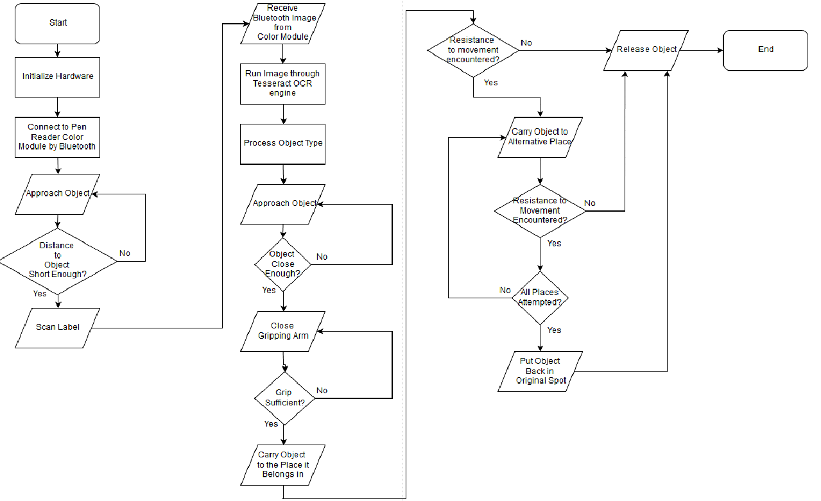
Plan of action
Robot Arm Control Software Workflow:
Notes:
This domain has controls around safeguarding assets. Some of the controls that this domain deals with are around the inventory of assets, ownership of assets, acceptable use of assets, return of assets.
It suggests controls around maintaining an inventory of assets and whether that inventory is current and kept up to date.
Also, it suggests that all information assets must have a clearly defined owner who is aware of their responsibilities.
It suggests that there be an acceptable use policy in place and there is process in place by which all employees are made aware of such policies.

Slide 10




Simulations
Input: Mixed colors, High, Medium & Low Resolution.
Notes:
This domain has controls around safeguarding assets. Some of the controls that this domain deals with are around the inventory of assets, ownership of assets, acceptable use of assets, return of assets.
It suggests controls around maintaining an inventory of assets and whether that inventory is current and kept up to date.
Also, it suggests that all information assets must have a clearly defined owner who is aware of their responsibilities.
It suggests that there be an acceptable use policy in place and there is process in place by which all employees are made aware of such policies.

Slide 11




Simulations
Sobel Filter
Notes:
This domain has controls around safeguarding assets. Some of the controls that this domain deals with are around the inventory of assets, ownership of assets, acceptable use of assets, return of assets.
It suggests controls around maintaining an inventory of assets and whether that inventory is current and kept up to date.
Also, it suggests that all information assets must have a clearly defined owner who is aware of their responsibilities.
It suggests that there be an acceptable use policy in place and there is process in place by which all employees are made aware of such policies.

Slide 12




Simulations
Cosine Similarity Method
Notes:
This domain has controls around safeguarding assets. Some of the controls that this domain deals with are around the inventory of assets, ownership of assets, acceptable use of assets, return of assets.
It suggests controls around maintaining an inventory of assets and whether that inventory is current and kept up to date.
Also, it suggests that all information assets must have a clearly defined owner who is aware of their responsibilities.
It suggests that there be an acceptable use policy in place and there is process in place by which all employees are made aware of such policies.

Slide 13



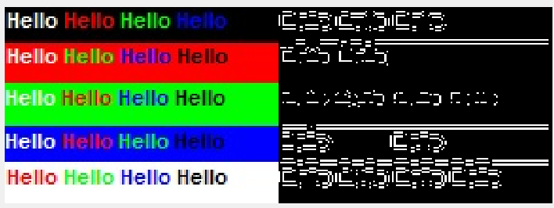
Simulations
Canny and Sobel filters
Notes:
This domain has controls around safeguarding assets. Some of the controls that this domain deals with are around the inventory of assets, ownership of assets, acceptable use of assets, return of assets.
It suggests controls around maintaining an inventory of assets and whether that inventory is current and kept up to date.
Also, it suggests that all information assets must have a clearly defined owner who is aware of their responsibilities.
It suggests that there be an acceptable use policy in place and there is process in place by which all employees are made aware of such policies.

Slide 14




Simulations
Canny Edge Detection Method
Notes:
This domain has controls around safeguarding assets. Some of the controls that this domain deals with are around the inventory of assets, ownership of assets, acceptable use of assets, return of assets.
It suggests controls around maintaining an inventory of assets and whether that inventory is current and kept up to date.
Also, it suggests that all information assets must have a clearly defined owner who is aware of their responsibilities.
It suggests that there be an acceptable use policy in place and there is process in place by which all employees are made aware of such policies.

Slide 15

Standard
The Bluetooth standard will be used to send images received by the pen reader to the robot arm wirelessly.
The chosen standard is
"IEEE 802.15.1: WPAN / Bluetooth"
Notes:
This domain has controls around safeguarding assets. Some of the controls that this domain deals with are around the inventory of assets, ownership of assets, acceptable use of assets, return of assets.
It suggests controls around maintaining an inventory of assets and whether that inventory is current and kept up to date.
Also, it suggests that all information assets must have a clearly defined owner who is aware of their responsibilities.
It suggests that there be an acceptable use policy in place and there is process in place by which all employees are made aware of such policies.

Slide 16
Commercialization
Features:
Our improved reading pen is more convenient and a time saver compared to using a dictionary.
There is no color limitation on characters you scan.
Action:
Plan and implement BTL marketing activities to ask for feedback
Problems in Commercialization:
How to carry out the business operations
How to maximize the market acceptance

Slide 17
Limitations and further development
OCR technology
Limitation in recognizing several parallel character lines.
We will try to restrict the scan area or improve the algorithm
Pen
The pen uses red light, so it can’t be used in colorful materials.
We will try to adapt the scanner to use white light, use filters or try a color-sensitive sensor
Recognition algorithm
The algorithm has low precision for hand-written characters.
We will try to combine several OCR algorithms to enhance precision
Resource limitation
We haven’t got any technical document of our pen and we haven’t got the pen as well.
Notes:
This domain has controls around safeguarding assets. Some of the controls that this domain deals with are around the inventory of assets, ownership of assets, acceptable use of assets, return of assets.
It suggests controls around maintaining an inventory of assets and whether that inventory is current and kept up to date.
Also, it suggests that all information assets must have a clearly defined owner who is aware of their responsibilities.
It suggests that there be an acceptable use policy in place and there is process in place by which all employees are made aware of such policies.

Slide 18
3. IMPACT
3
Ethical and societal impacts

Slide 19

Impact
Our reading pen can help people with dyslexia
Our reading pen can help people who are visually impaired
People who are not familiar with English can also use this pen to help them work.
People who have disabilities in arm or hands can also use our reading pen to control some robotic arms to do some normal action.
Notes:
This domain has controls around safeguarding assets. Some of the controls that this domain deals with are around the inventory of assets, ownership of assets, acceptable use of assets, return of assets.
It suggests controls around maintaining an inventory of assets and whether that inventory is current and kept up to date.
Also, it suggests that all information assets must have a clearly defined owner who is aware of their responsibilities.
It suggests that there be an acceptable use policy in place and there is process in place by which all employees are made aware of such policies.

Slide 20
References
[1] Siegel, Linda S. “Perspectives on Dyslexia.”, Paediatrics & Child Health 11.9 (2006): 581–587. Print.
[2] Bailey R. N., Indian R. W., Zhang X., Geiss L. S., Duenas M.R., Saaddine J. B. “Visual impairment and eye care among older adults—five states,” MMWR 2006; 55(49):1321–1325.
[3] Eikvil, Line. "OCR-Optical Character Recognition.", 1993.
Notes:
This domain has controls around safeguarding assets. Some of the controls that this domain deals with are around the inventory of assets, ownership of assets, acceptable use of assets, return of assets.
It suggests controls around maintaining an inventory of assets and whether that inventory is current and kept up to date.
Also, it suggests that all information assets must have a clearly defined owner who is aware of their responsibilities.
It suggests that there be an acceptable use policy in place and there is process in place by which all employees are made aware of such policies.

Slide 21
Thank you.

